Slide 1

2020 Capstone Design
Development of a Drowsiness Recognition LMS using Azure cognitive service
Professor Wooje Kim
15146303 Seongmo Goo
15146319 Jihoon Lee
17102054 Inkyun Ahn

Slide 2
Contents
1. Project Background and Features
2. Explanation of project content
3. Demonstration video

Slide 3
Project Background
and Features

Slide 4
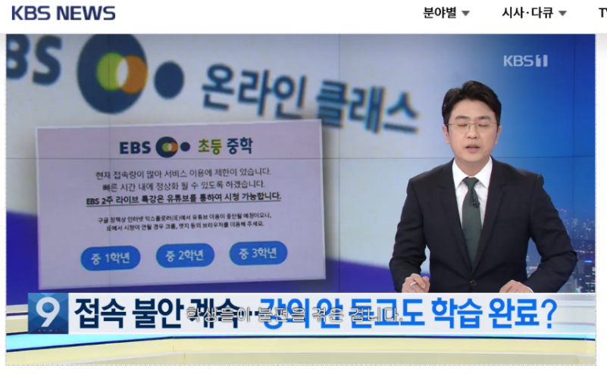
연구 개발 배경
1. Development Background
Lectures are being replaced by online lectures due to COVID-19. However, with the existing online lecture system, it is difficult to capture the student's attitude in class, and there are disadvantages of poor concentration.
The purpose of this study is to design and develop a natural user interface LMS that can improve the concentration of lectures by utilizing speech recognition and facial recognition.

Slide 5
연구 개발 배경
1. Work Development Environment
Division |  | Description
S/W Development Environment | OS | Windows10
 | IDE | Visual studio code
 | Development tools | Git, Python, Django
 | Development language | python, javascript, html
 | Database | mysql, sqlite
H/W Components Equipment | Device | Laptop computer
 | Addition | Microphone, Webcam

Slide 6
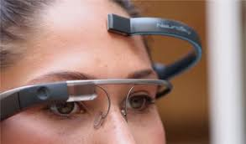
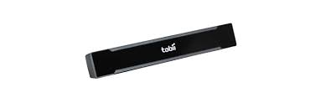
작품의 특징
1. Characteristics
Simple Equipment Requirements regardless of time and location
Students can improve their course attitude after identifying
their course attitude using just webcams and microphone.
Create an offline-like environment and various options
Real-time video control based on absence, proxy attendance, and sleepiness detection.
If the system determines that you are dozing off during a lecture, the video automatically stops and only continuously listens through voice recognition.
Voice recognition enables video manipulation of lectures
Image clip and each figure at the point of sleepiness.
Provide a graph and table of the course attitude results of the students after the course is over.
Notes:
기존의 LMS 태도 분석 연구는 뇌파 감지, 토비 아이 트래커 등 고가의 장비들을 필요로 하며 많은 전문성 장비가 요구됨, 국내 및 해외에서 학습자 태도 분석에 대한 연구는 진행되고 있지만 실용화되지 않음. 기존 연구와 차이점.

Slide 7
2. Explanation of project content

Slide 8
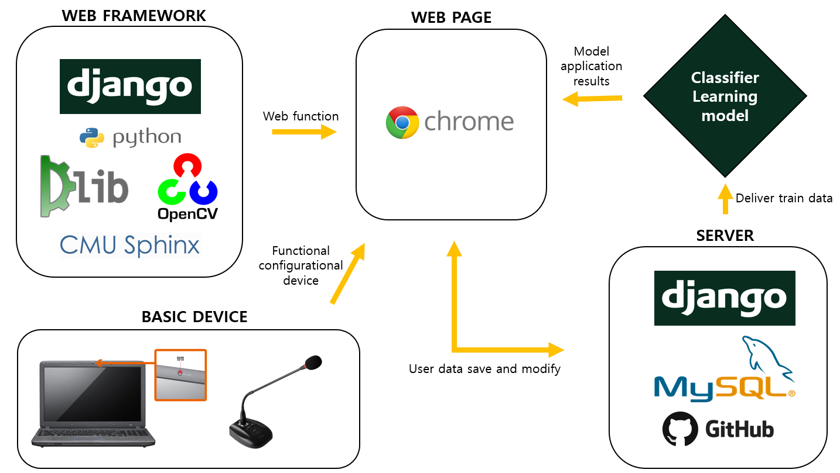
시스템 구성도
2. System Configuration Diagram

Slide 9
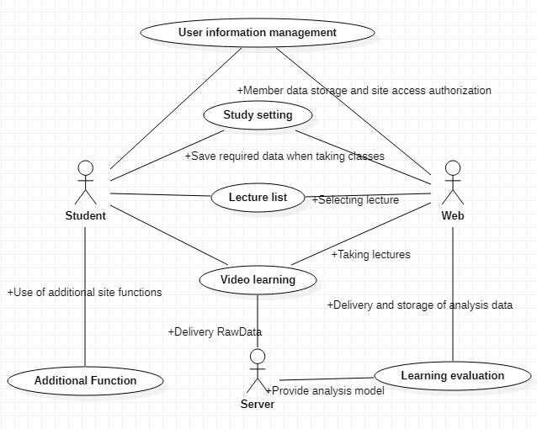
프로젝트 전체 기능
2. Project-wide capabilities
Usecase ID | Usecase | Sub Usecase | Actor | Subject
Uc-01-001 | User information management | Join membership | Student | WEB
Uc-01-002 | User information management | Login | Student | WEB
Uc-01-003 | User information management | Learning record check | Student | WEB
Uc-01-004 | User information management | Download learning results | Student | WEB
Uc-02-001 | Learning Settings | Entering the test | Student | WEB
Uc-02-002 | Learning Settings | Microphone test | Student | WEB
Uc-02-003 | Learning Settings | Webcam test | Student | WEB
Uc-02-004 | Learning Settings | Calculating the Eye Threshold | Student | WEB
Uc-02-005 | Learning Settings | Face registration | Student | WEB
Uc-02-006 | Learning Settings | Test Results | Student | WEB
Uc-03-001 | List of courses | Course list | Student | WEB
Uc-03-002 | List of courses | Select a course | Student | WEB
Uc-04-001 | Video learning | Face recognition | Student | SERVER
Uc-04-002 | Video learning | Video play | Student | WEB/ SERVER
Uc-04-003 | Video learning | Sleep awareness and prevention warning | Student | SERVER
Uc-04-004 | Video learning | Sleep status signal lamp display | Student | WEB
Uc-04-005 | Video learning | Eye Size Real-Time Graphs | Student | SERVER
Uc-04-006 | Video learning | Control lectures through voice commands | Student | WEB
Uc-04-007 | Video learning | Record the running time of a video | Student | SERVER
Uc-04-008 | Video learning | Voice Concentration Test | Student | SERVER
Uc-04-009 | Video learning | Concentration test using voice answer | Student | WEB
Uc-04-010 | Video learning | Video replay | Student | WEB
Uc-05-001 | Learning Assessment | Class attitude analysis | Student | SERVER
Uc-05-002 | Learning Assessment | Display analysis results | Student | SERVER
Uc-06-001 | Additional function | Q&A | Student | WEB

Slide 10
2. Process flow chart
Database (MySQL)
Algorithm(Python)
View(JavaScript)
Web Socket
communication
Load test result value
(Snow threshold, user photo, etc.)
Acquire a face image from a webcam
Video start
Face Analysis
by using Face API
Video control
(depending on the outcome of the judgment)
User face recognition &
sleep judgment
Video end
Save results for users by course
(Sleeping Status, Emotion, Posture)
Store analysis results in DB
Analysis result page

Slide 11
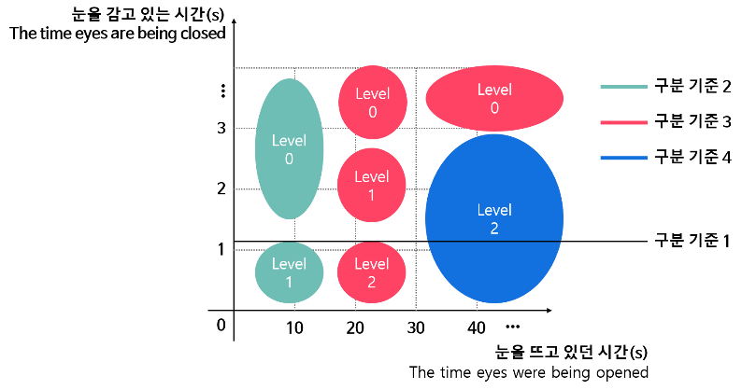
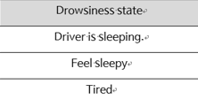
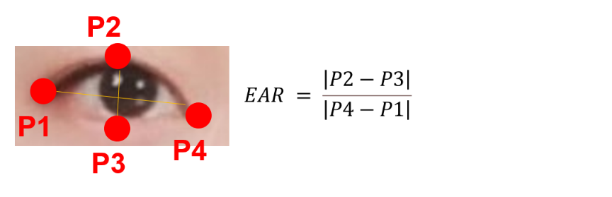
2. Key screens
Face specific position & calculation formula
3 Level of drowsiness
Using the Azure Face API, the specific location of the face is extracted from each point and the threshold is calculated.
The calculated EAR (Eye Average Ratio) has a non-zero numerical value when the eyes are open, and a value close to zero when the eyes are closed.
Thresholds are calculated using the average EAR value with eyes open for 7 seconds and the average EAR value with eyes closed.
Thresholds are used to check learners' real-time sleepiness
- Criteria 1: The first alarm (approximately 0.9 seconds) sounds between the sleep phase 1 and 2.
- Criteria 2: If you are repeatedly drowsy for less than 15 seconds, the sleep phase starts at 1 and the alarm goes up to 0 continuously.
- Criteria 3: The first alarm sounds level1, the second alarm sounds level 2, and the third alarm sounds level 3.
- Criteria 4: If you don't doze for more than 30 seconds, set to step 2.

Slide 12
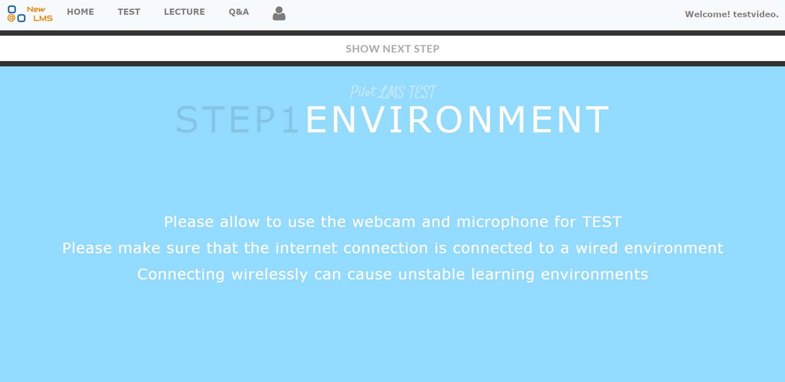
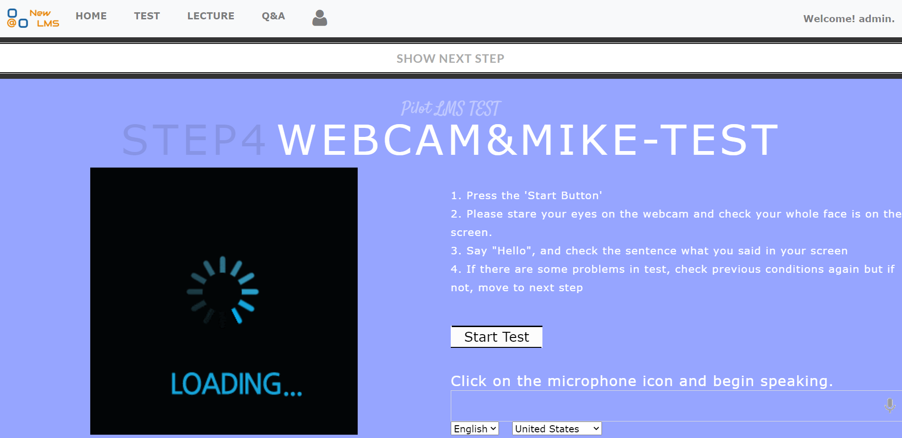
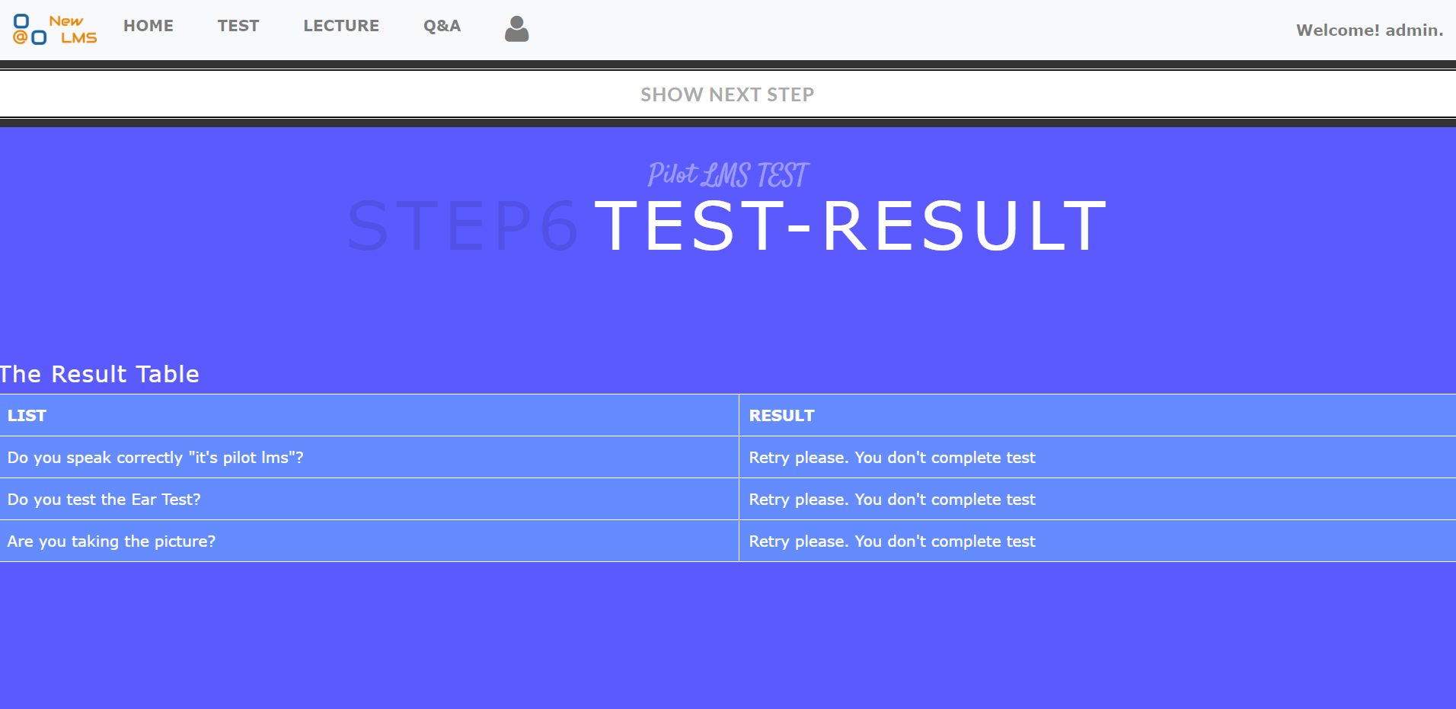
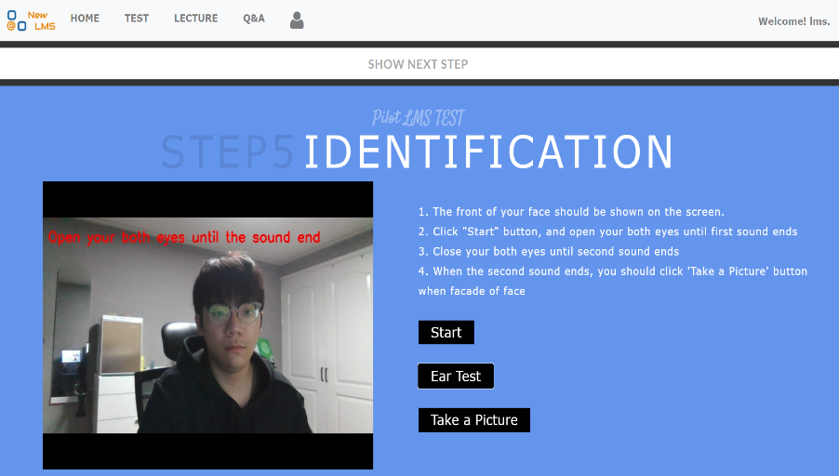
프로세스 흐름도
2. Key screens
Test precautions
Webcam & Microphone test
Test result
Register photos and register eye thresholds

Slide 13
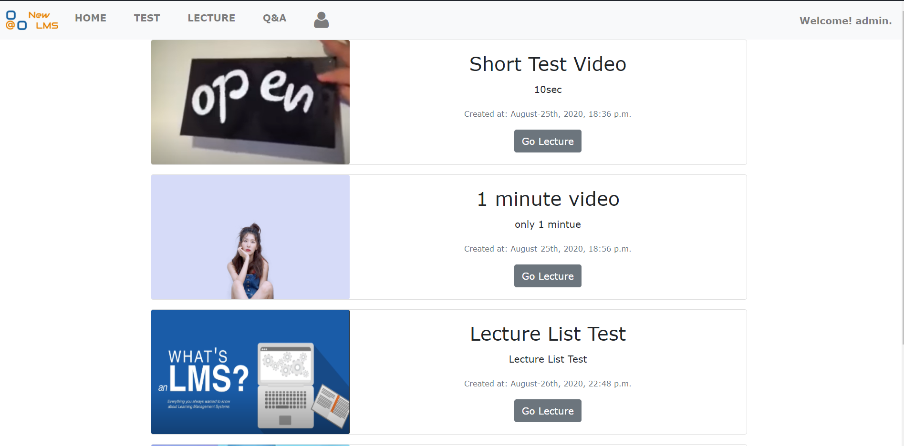
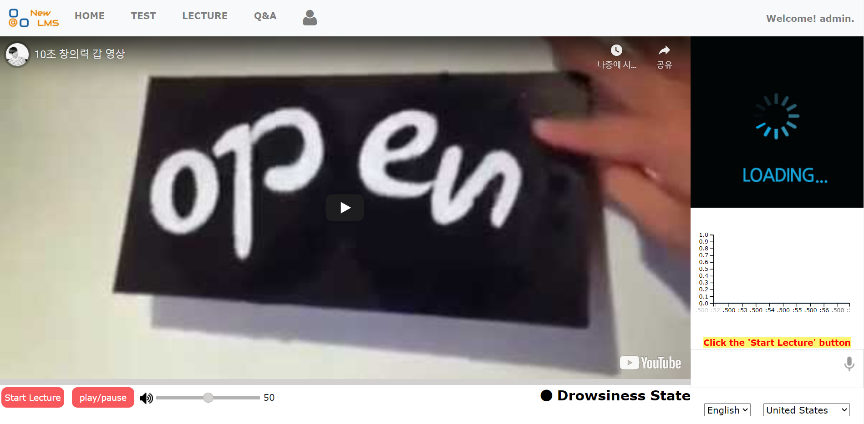
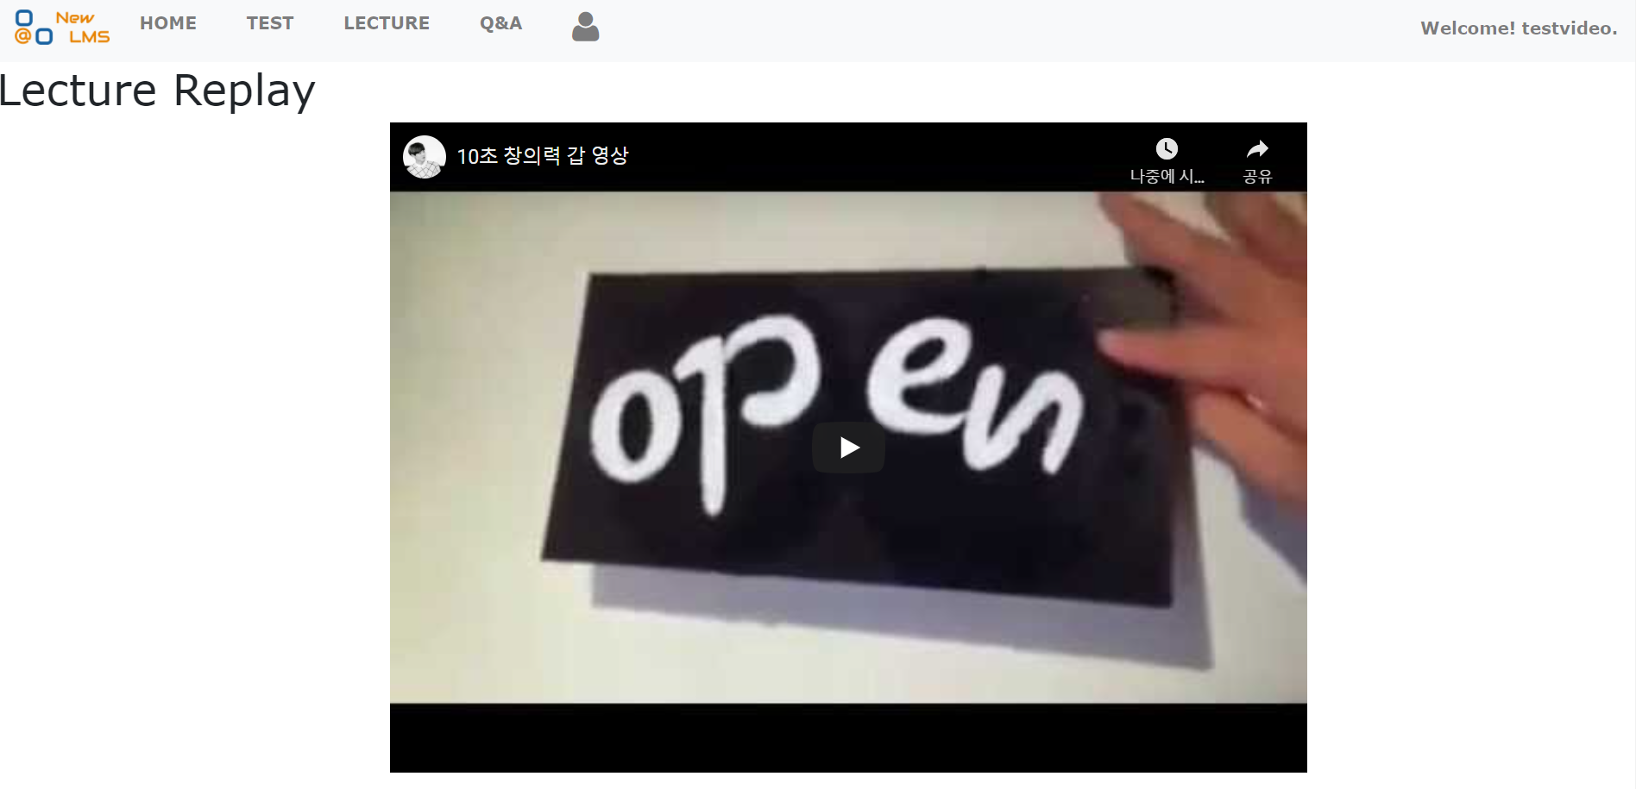
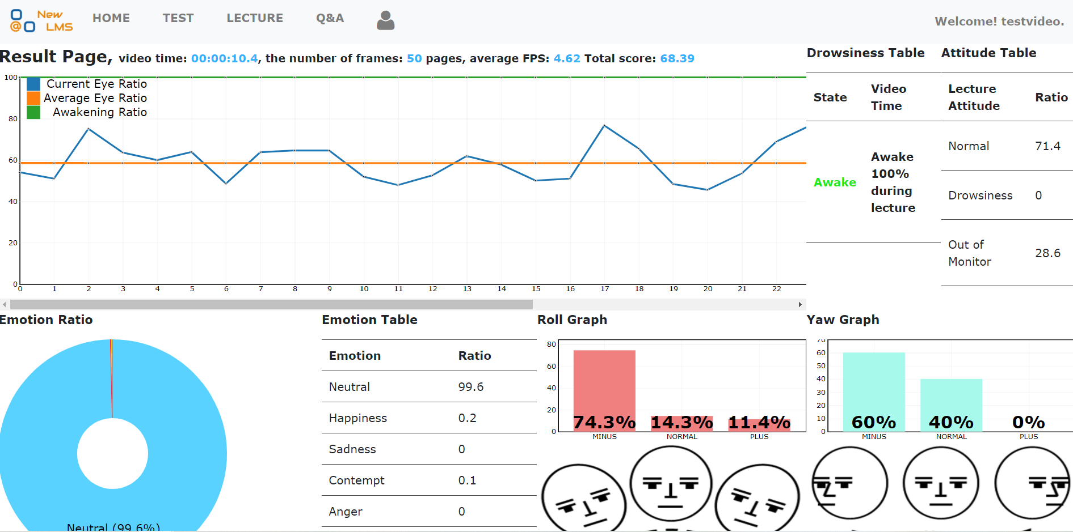
프로세스 흐름도
2. Key screens
the first round
Course list
Lecture screen
다시 듣기 화면
강의 결과
Replay
Lecture results

Slide 14
기대 효과
2. Expected Effect
Differentiated systems from existing LMS
By giving students a student attitude score, they can induce participation through comparison with others and actively induce a class attitude by reflecting the attendance score.
Improved compulsory concentration by identifying the concentration of students through microphones and webcams for online classes that may be loose.
Development of customized lecture patterns reflecting individual online lecture characteristics ﬁ Quantifying learning results enables objective evaluation of participation in classes (e.g., attendance).
Can be used in a variety of facilities
Digital technology can be applied to classes in educational facilities such as elementary, middle, high school, and academies.
Unlike conventional online lectures, it seems that the quality of the lecture listening rate can be improved through more intensive and evaluated by students through technical concentration and evaluation of students.
Quantitative management of real-time online lecture evaluation (class attendance).

Slide 15
3. Demonstration video

Slide 16


Slide 17
Thank you

